Slide 1
Relational Model / Relational Algebra
Structure of Relational Databases
Relational Algebra
Tuple Relational Calculus
Domain Relational Calculus
Extended Relational-Algebra-Operations
Modification of the Database
Views

Slide 2
Null Values
It is possible for tuples to have a null value, denoted by null, for some of their attributes
null signifies an unknown value or that a value does not exist.
The result of any arithmetic expression involving null is null.
Aggregate functions simply ignore null values
  Is an arbitrary decision. Could have returned null as result instead.
  We follow the semantics of SQL in its handling of null values
For duplicate elimination and grouping, null is treated like any other value, and two nulls are assumed to be the same
  Alternative: assume each null is different from each other
  Both are arbitrary decisions, so we simply follow SQL

Slide 3
Null Values
Comparisons with null values return the special truth value unknown
  If false was used instead of unknown, then not (A < 5)
  would not be equivalent to A >= 5
Three-valued logic using the truth value unknown:
  OR: (unknown or true) = true,
  (unknown or false) = unknown
  (unknown or unknown) = unknown
  AND: (true and unknown) = unknown,
  (false and unknown) = false,
  (unknown and unknown) = unknown
  NOT: (not unknown) = unknown
  In SQL “P is unknown” evaluates to true if predicate P evaluates to unknown
Result of select predicate is treated as false if it evaluates to unknown

Slide 4
Modification of the Database
The content of the database may be modified using the following operations:
  Deletion
  Insertion
  Updating
All these operations are expressed using the assignment operator.

Slide 5
Deletion
A delete request is expressed similarly to a query, except instead of displaying tuples to the user, the selected tuples are removed from the database.
Can delete only whole tuples; cannot delete values on only particular attributes
A deletion is expressed in relational algebra by:
r ← r – E
where r is a relation and E is a relational algebra query.

Slide 6
Deletion Examples
Delete all account records in the Perryridge branch.
account  account –  _{branch-name = “Perryridge”} (account)
Delete all loan records with amount in the range of 0 to 50
loan  loan –  _{amount  0 and amount  50} (loan)
Delete all accounts at branches located in Needham.
r₁  _{ branch-city = “Needham”} (account branch)
r₂  branch-name, account-number, balance (r₁)
r₃   _{customer-name, account-number} (r₂ depositor)
account  account – r₂
depositor  depositor – r₃

Slide 7
Insertion
To insert data into a relation, we either:
  specify a tuple to be inserted
  write a query whose result is a set of tuples to be inserted
in relational algebra, an insertion is expressed by:
r ← r ∪ E
where r is a relation and E is a relational algebra expression.
The insertion of a single tuple is expressed by letting E be a constant relation containing one tuple.

Slide 8
Insertion Examples
Insert information in the database specifying that Smith has $1200 in account A-973 at the Perryridge branch.
account  account  {(“Perryridge”, A-973, 1200)}
depositor  depositor  {(“Smith”, A-973)}
Provide as a gift for all loan customers in the Perryridge
branch, a $200 savings account. Let the loan number serve
as the account number for the new savings account.
r₁  (_{branch-name = “Perryridge”} (borrower loan))
account  account  branch-name, account-number,200 (r₁)
depositor  depositor  _{customer-name, loan-number}(r₁)

Slide 9
Updating
A mechanism to change a value in a tuple without charging all values in the tuple
Use the generalized projection operator to do this task
r ← ∏ _{F1, F2, …, FI,} (r)
Each F_{i} is either
  the ith attribute of r, if the ith attribute is not updated, or,
  if the attribute is to be updated F_{i} is an expression, involving only constants and the attributes of r, which gives the new value for the attribute

Slide 10
Update Examples
Make interest payments by increasing all balances by 5 percent.
account   _{AN, BN, BAL * 1.05} (account)
where AN, BN and BAL stand for account-number, branch-name and balance, respectively.
Pay all accounts with balances over $10,000 6 percent interest
and pay all others 5 percent
account   _{AN, BN, BAL * 1.06} ( _{BAL  10000} (account))
 _{AN, BN, BAL * 1.05} (_{BAL  10000} (account))

Slide 11
Views
In some cases, it is not desirable for all users to see the entire logical model (i.e., all the actual relations stored in the database.)
Consider a person who needs to know a customer’s loan number but has no need to see the loan amount. This person should see a relation described, in the relational algebra, by
∏_{customer-name, loan-number} (borrower loan)
Any relation that is not of the conceptual model but is made visible to a user as a “virtual relation” is called a view.

Slide 12
View Definition
A view is defined using the create view statement which has the form
create view v as <query expression
where <query expression> is any legal relational algebra query expression. The view name is represented by v.
Once a view is defined, the view name can be used to refer to the virtual relation that the view generates.
View definition is not the same as creating a new relation by evaluating the query expression
  Rather, a view definition causes the saving of an expression; the expression is substituted into queries using the view.

Slide 13
View Examples
Consider the view (named all-customer) consisting of branches and their customers.
create view all-customer as
_{branch-name, customer-name} (depositor account)
 _{branch-name, customer-name} (borrower loan)
We can find all customers of the Perryridge branch by writing:
_{customer-name}
(_{branch-name = “Perryridge”} (all-customer))

Slide 14
Updates Through View
Database modifications expressed as views must be translated to modifications of the actual relations in the database.
Consider the person who needs to see all loan data in the loan relation except amount. The view given to the person, branch-loan, is defined as:
create view branch-loan as
∏_{branch-name, loan-number} (loan)
Since we allow a view name to appear wherever a relation name is allowed, the person may write:
branch-loan ← branch-loan ∪ {(“Perryridge”, L-37)}

Slide 15
Updates Through Views (Cont.)
The previous insertion must be represented by an insertion into the actual relation loan from which the view branch-loan is constructed.
An insertion into loan requires a value for amount. The insertion can be dealt with by either.
  rejecting the insertion and returning an error message to the user.
  inserting a tuple (“L-37”, “Perryridge”, null) into the loan relation
Some updates through views are impossible to translate into database relation updates
  create view v as σ_{branch-name = “Perryridge”} (account))
  v ← v ∪ (L-99, Downtown, 23)
Others cannot be translated uniquely
  all-customer ← all-customer ∪ {(“Perryridge”, “John”)}
    Have to choose loan or account, and
    create a new loan/account number!

Slide 16
Views Defined Using Other Views
One view may be used in the expression defining another view
A view relation v₁ is said to depend directly on a view relation v₂ if v₂ is used in the expression defining v₁
A view relation v₁ is said to depend on view relation v₂ if either v₁ depends directly to v₂ or there is a path of dependencies from v₁ to v₂
A view relation v is said to be recursive if it depends on itself.

Slide 17
View Expansion
A way to define the meaning of views defined in terms of other views.
Let view v₁ be defined by an expression e₁ that may itself contain uses of view relations.
View expansion of an expression repeats the following replacement step:
repeat
Find any view relation v_{i} in e₁
Replace the view relation v_{i} by the expression defining v_{i}
until no more view relations are present in e₁
As long as the view definitions are not recursive, this loop will terminate

Slide 18
Tuple Relational Calculus
A nonprocedural query language, where each query is of the form
{t | P (t) }
It is the set of all tuples t such that predicate P is true for t
t is a tuple variable, t[A] denotes the value of tuple t on attribute A
t ∈ r denotes that tuple t is in relation r
P is a formula similar to that of the predicate calculus

Slide 19
Predicate Calculus Formula
1. Set of attributes and constants
2. Set of comparison operators: (e.g., <, ≤, =, ≠, >, ≥)
3. Set of connectives: and (∧), or (v)‚ not (¬)
4. Implication (⇒): x ⇒ y, if x if true, then y is true
x ⇒ y ≡ ¬x v y
5. Set of quantifiers:
  ∃ t ∈ r (Q(t)) ≡ ”there exists” a tuple in t in relation r
  such that predicate Q(t) is true
  ∀t ∈ r (Q(t)) ≡ Q is true “for all” tuples t in relation r

Slide 20
Banking Example
branch (branch-name, branch-city, assets)
customer (customer-name, customer-street, customer-city)
account (account-number, branch-name, balance)
loan (loan-number, branch-name, amount)
depositor (customer-name, account-number)
borrower (customer-name, loan-number)

Slide 21
Example Queries
Find the loan-number, branch-name, and amount for loans of over $1200
{t | t  loan  t [amount]  1200}
Find the loan number for each loan of an amount greater than $1200
{t |  s  loan (t[loan-number] = s[loan-number]  s [amount]  1200)}
Notice that a relation on schema [loan-number] is implicitly defined by the query

Slide 22
Example Queries
Find the names of all customers having a loan, an account, or both at the bank
{t | s  borrower( t[customer-name] = s[customer-name])
 u  depositor( t[customer-name] = u[customer-name])
Find the names of all customers who have a loan and an account
at the bank
{t | s  borrower( t[customer-name] = s[customer-name])
 u  depositor( t[customer-name] = u[customer-name])

Slide 23
Example Queries
Find the names of all customers having a loan at the Perryridge branch
{t | s  borrower(t[customer-name] = s[customer-name]
 u  loan(u[branch-name] = “Perryridge”
 u[loan-number] = s[loan-number]))}
Find the names of all customers who have a loan at the
Perryridge branch, but no account at any branch of the bank
{t | s  borrower( t[customer-name] = s[customer-name]
 u  loan(u[branch-name] = “Perryridge”
 u[loan-number] = s[loan-number]))
 not v  depositor (v[customer-name] =
t[customer-name]) }

Slide 24
Example Queries
Find the names of all customers having a loan from the Perryridge branch, and the cities they live in
{t | s  loan(s[branch-name] = “Perryridge”
 u  borrower (u[loan-number] = s[loan-number]
 t [customer-name] = u[customer-name])
  v  customer (u[customer-name] = v[customer-name]
 t[customer-city] = v[customer-city])))}

Slide 25
Example Queries
Find the names of all customers who have an account at all branches located in Brooklyn:
{t |  c  customer (t[customer.name] = c[customer-name]) 
 s  branch(s[branch-city] = “Brooklyn” 
 u  account ( s[branch-name] = u[branch-name]
  s  depositor ( t[customer-name] = s[customer-name]
 s[account-number] = u[account-number] )) )}

Slide 26
Safety of Expressions
It is possible to write tuple calculus expressions that generate infinite relations.
For example, {t | ¬ t ∈ r} results in an infinite relation if the domain of any attribute of relation r is infinite
To guard against the problem, we restrict the set of allowable expressions to safe expressions.
An expression {t | P(t)} in the tuple relational calculus is safe if every component of t appears in one of the relations, tuples, or constants that appear in P
  NOTE: this is more than just a syntax condition.
    E.g. { t | t[A]=5 ∨ true } is not safe --- it defines an infinite set with attribute values that do not appear in any relation or tuples or constants in P.

Slide 27
Domain Relational Calculus
A nonprocedural query language equivalent in power to the tuple relational calculus
Each query is an expression of the form:
{ < x₁, x₂, …, x_{n} > | P(x₁, x₂, …, x_{n})}
  x₁, x₂, …, x_{n} represent domain variables
  P represents a formula similar to that of the predicate calculus

Slide 28
Example Queries
Find the loan-number, branch-name, and amount for loans of over $1200
{ l, b, a  |  l, b, a   loan  a > 1200}
Find the names of all customers who have a loan of over $1200
{ c  |  l, b, a ( c, l   borrower   l, b, a   loan  a > 1200)}
Find the names of all customers who have a loan from the
Perryridge branch and the loan amount:
{ c, a  |  l ( c, l   borrower  b( l, b, a   loan 
b = “Perryridge”))}
or { c, a  |  l ( c, l   borrower   l, “Perryridge”, a   loan)}

Slide 29
Example Queries
Find the names of all customers having a loan, an account, or both at the Perryridge branch:
{ c  |  l ({ c, l   borrower
  b,a( l, b, a   loan  b = “Perryridge”))
  a( c, a   depositor
  b,n( a, b, n   account  b = “Perryridge”))}
Find the names of all customers who have an account at all
branches located in Brooklyn:
{ c  |  s, n ( c, s, n   customer) 
 x,y,z( x, y, z   branch  y = “Brooklyn”) 
 a,b( x, y, z   account   c,a   depositor)}

Slide 30
Safety of Expressions
{ < x₁, x₂, …, x_{n} > | P(x₁, x₂, …, x_{n})}
is safe if all of the following hold:
1. All values that appear in tuples of the expression are values from dom(P) (that is, the values appear either in P or in a tuple of a relation mentioned in P).
2. For every “there exists” subformula of the form ∃ x (P₁(x)), the subformula is true if and only if there is a value of x in dom(P₁) such that P₁(x) is true.
3. For every “for all” subformula of the form ∀_{x} (P₁ (x)), the subformula is true if and only if P₁(x) is true for all values x from dom (P₁).

Slide 31
End of Chapter 3

Slide 32
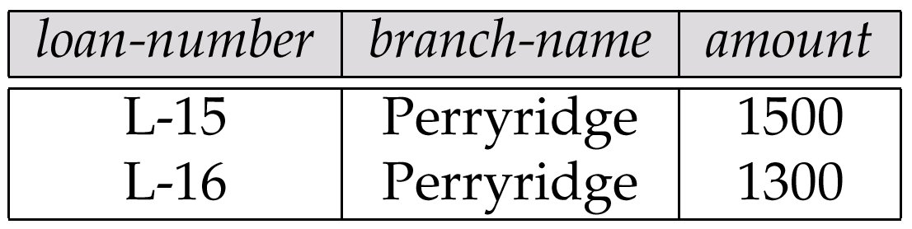
Result of σ _{branch-name = “Perryridge”} (loan)

Slide 33
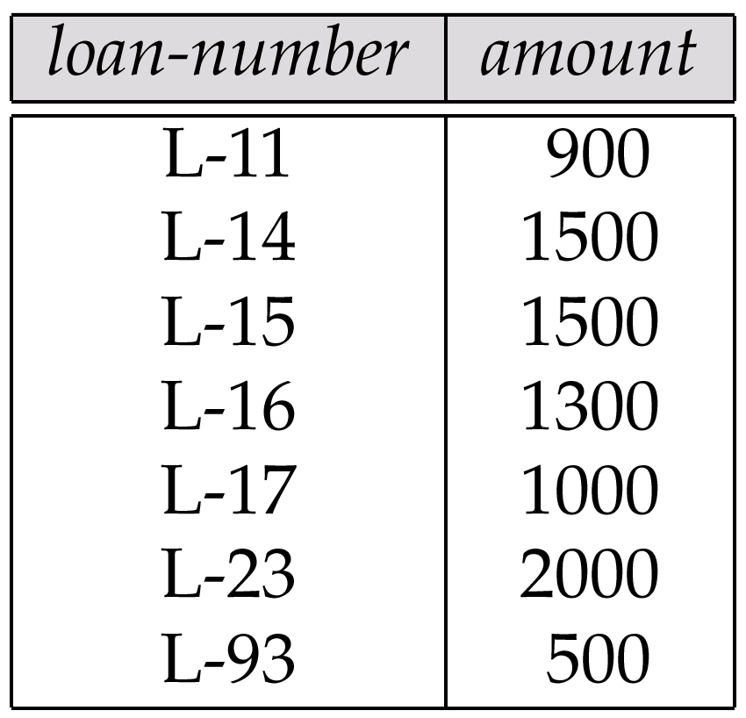
Loan Number and the Amount of the Loan

Slide 34
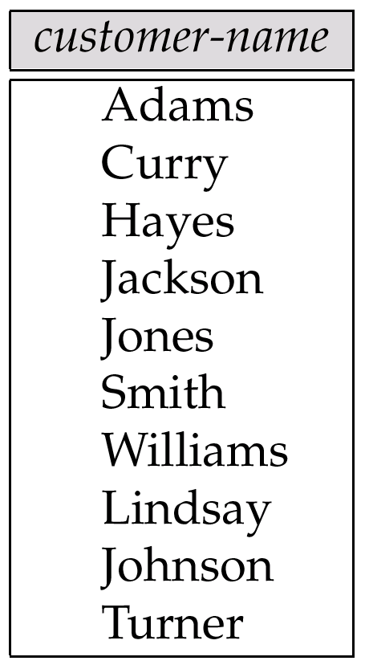
Names of All Customers Who Have Either a Loan or an Account

Slide 35
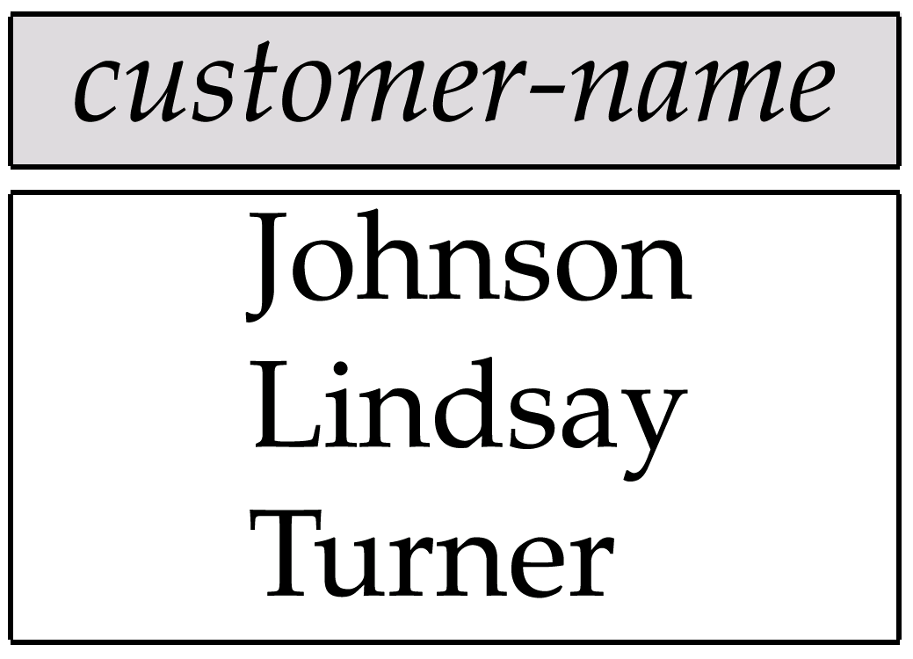
Customers With An Account But No Loan

Slide 36
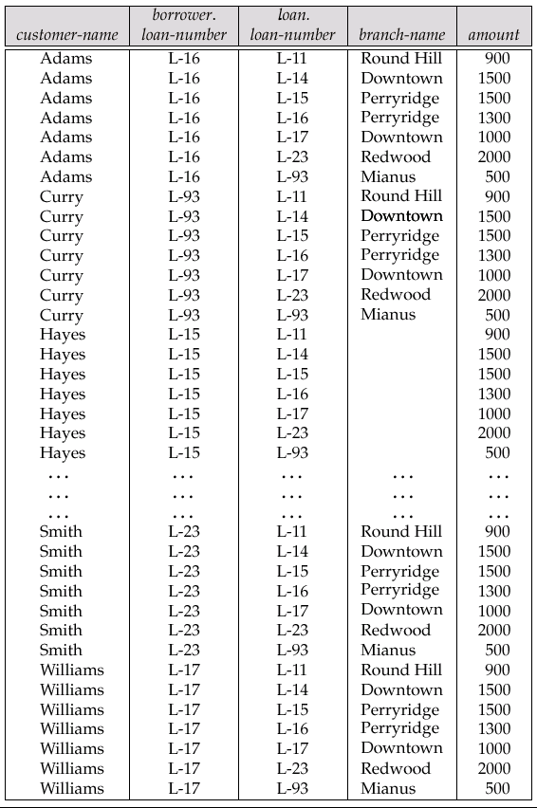
Result of borrower × loan

Slide 37
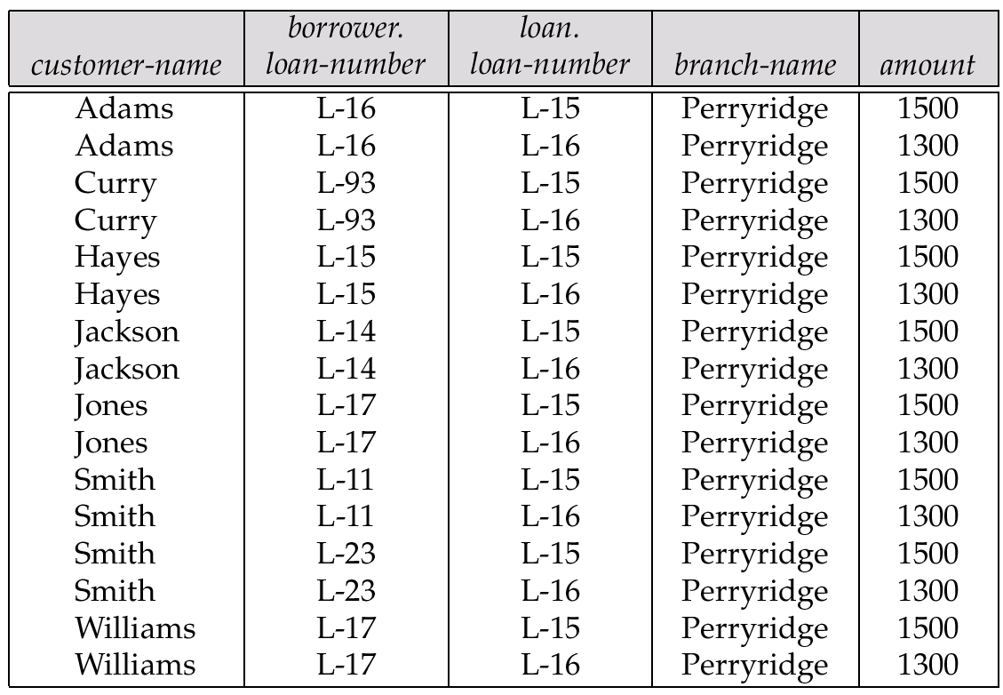
Result of σ _{branch-name = “Perryridge”} (borrower × loan)

Slide 38
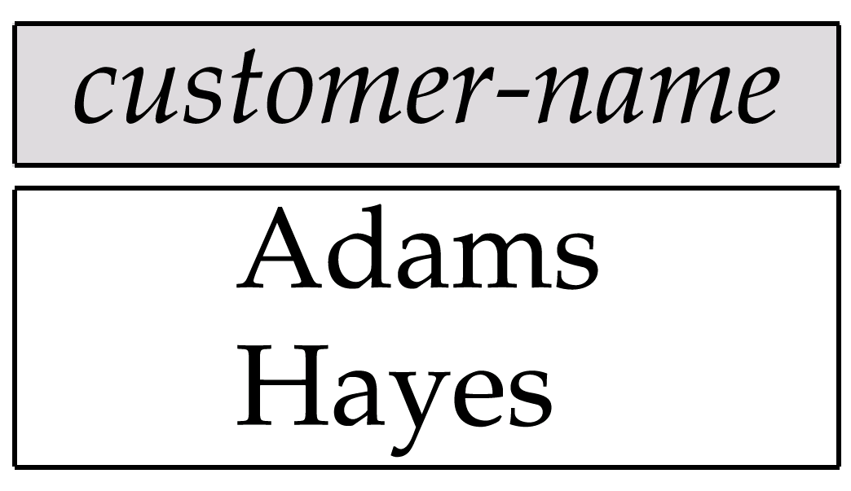
Result of Π_{customer-name}

Slide 39
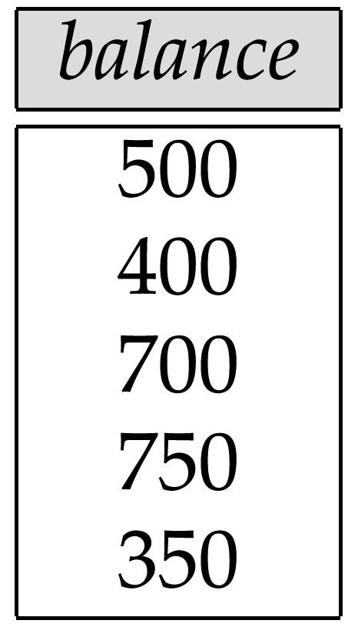
Result of the Subexpression

Slide 40
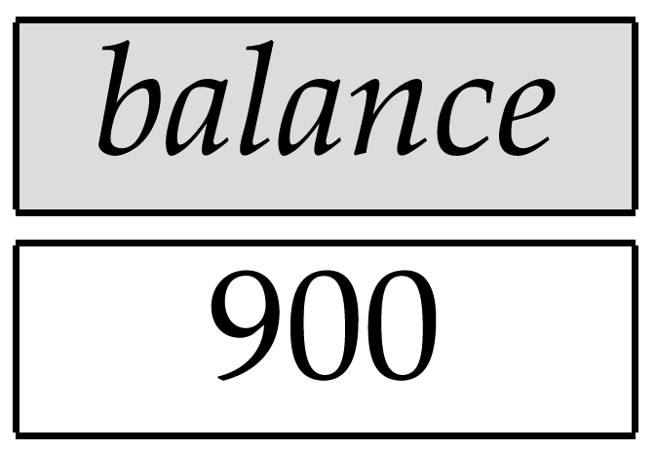
Largest Account Balance in the Bank

Slide 41
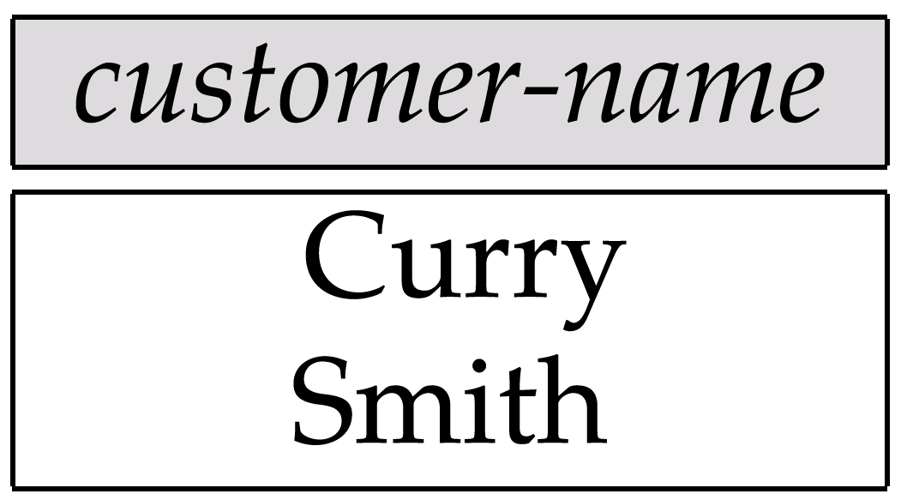
Customers Who Live on the Same Street and In the Same City as Smith

Slide 42
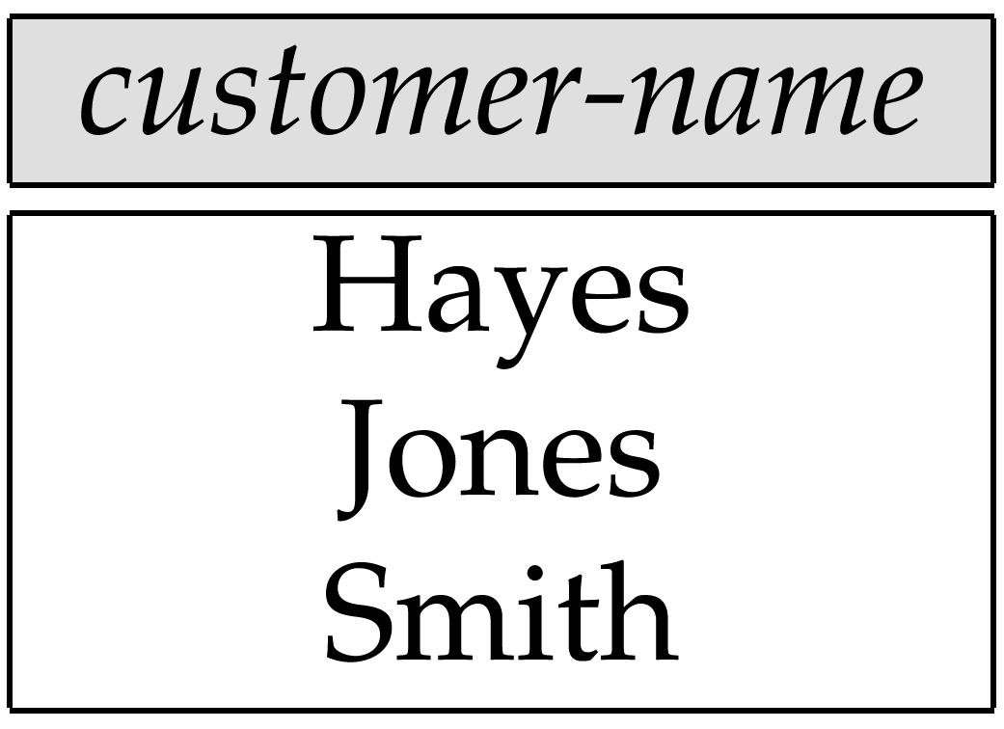
Customers With Both an Account and a Loan at the Bank

Slide 43
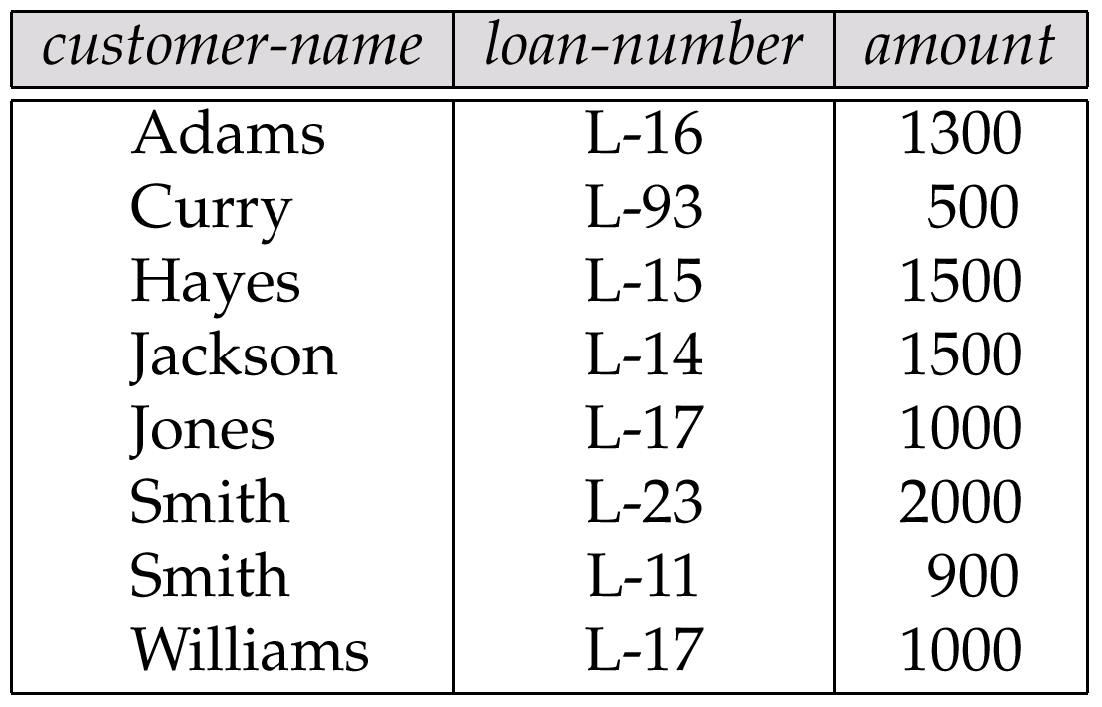
Result of Πcustomer-name, loan-number, amount (borrower loan)

Slide 44
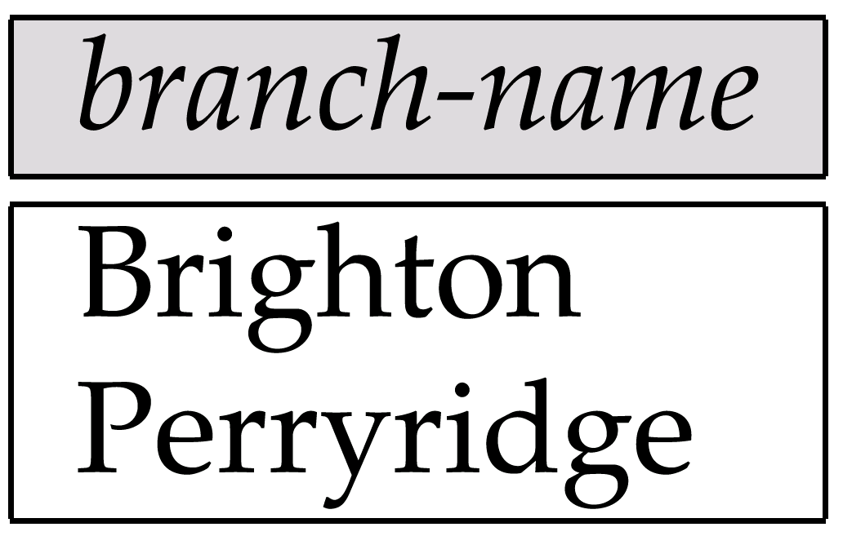
Result of Π_{branch-name}(σ_{customer-city = “Harrison”}(customer account depositor))

Slide 45
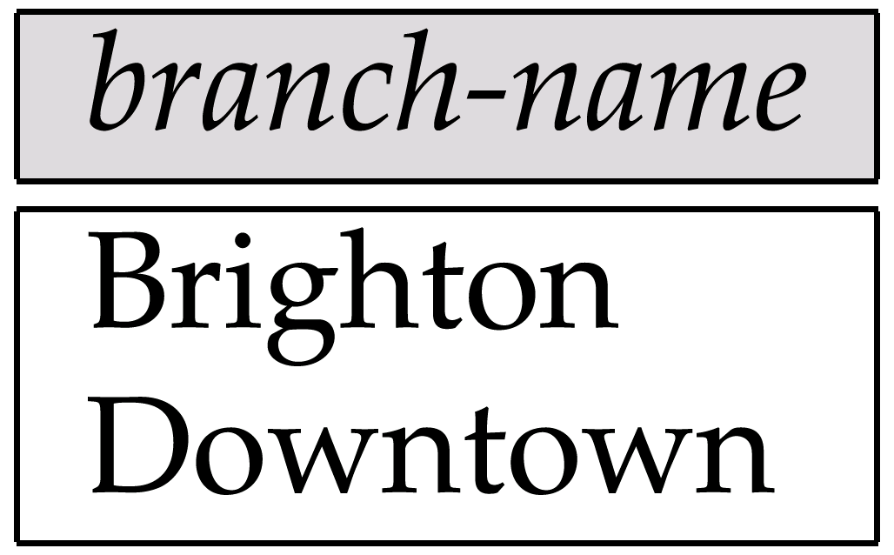
Result of Π_{branch-name}(σ_{branch-city =} “Brooklyn”^{(branch))}

Slide 46
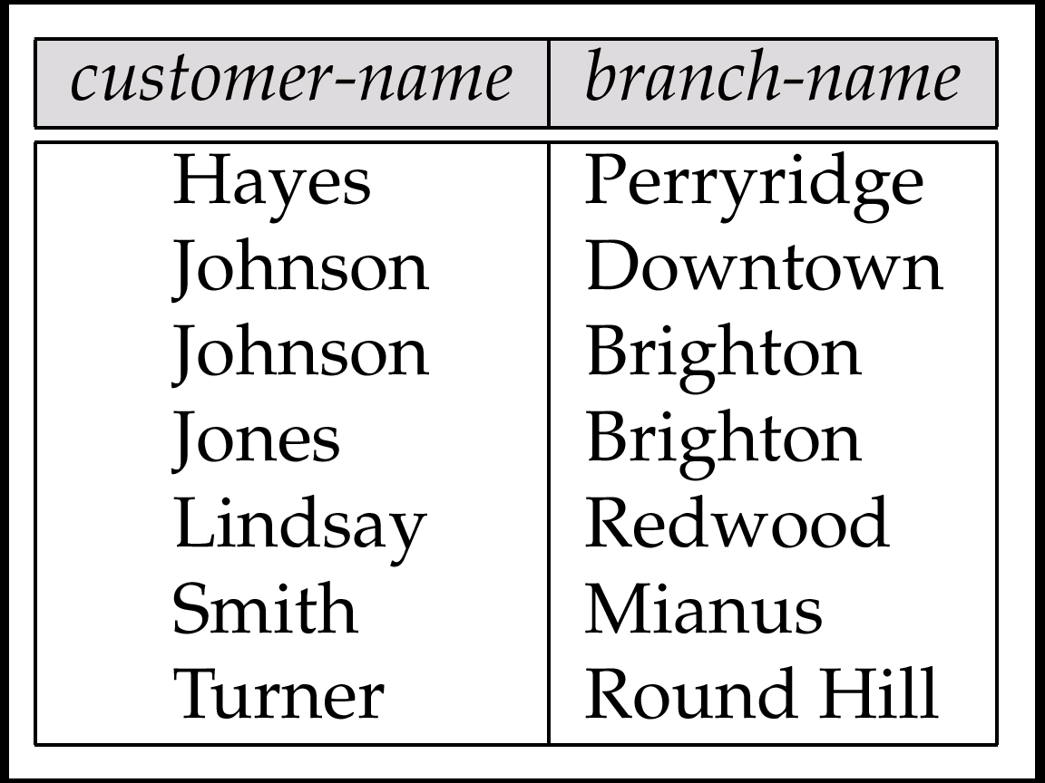
Result of Π_{customer-name, branch-name}(depositor account)

Slide 47
The credit-info Relation

Slide 48
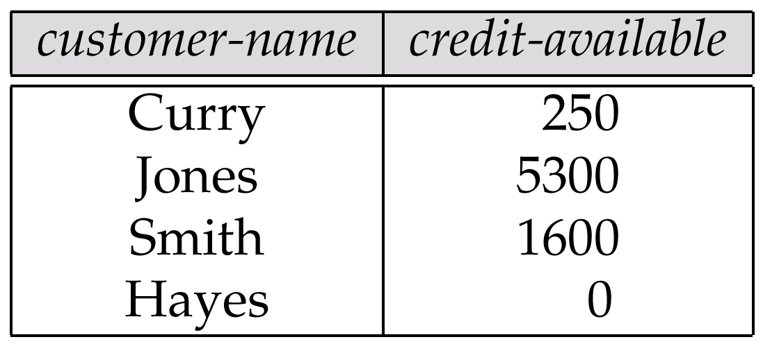
Result of Πcustomer-name, (limit – credit-balance) as credit-available(credit-info).

Slide 49
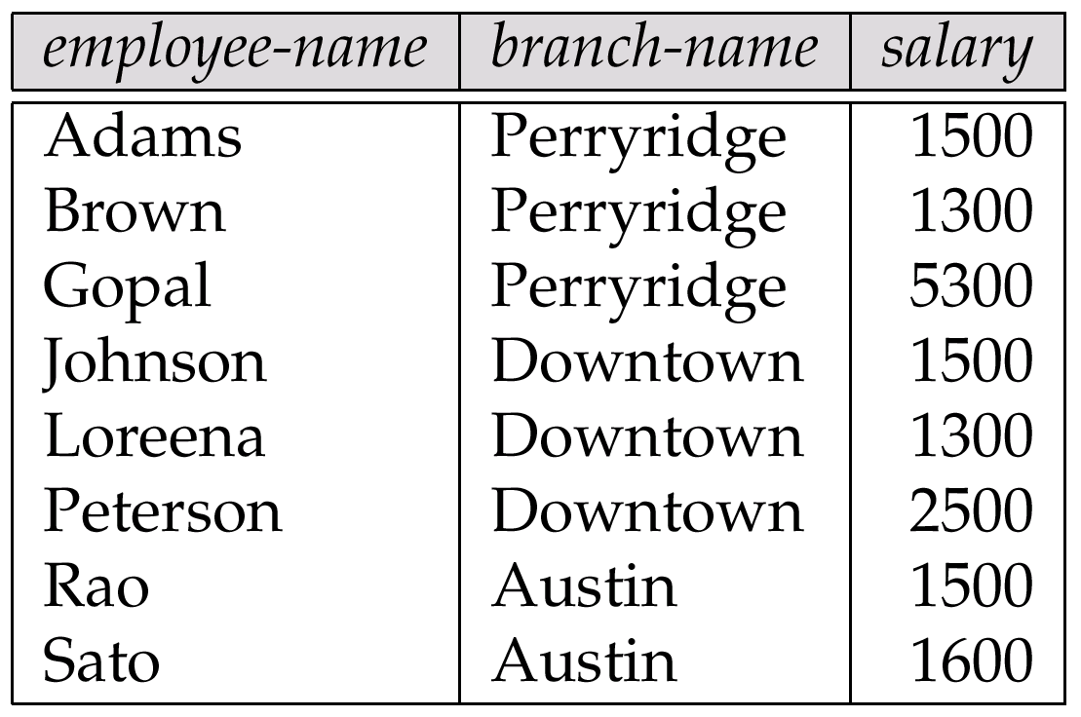
The pt-works Relation

Slide 50
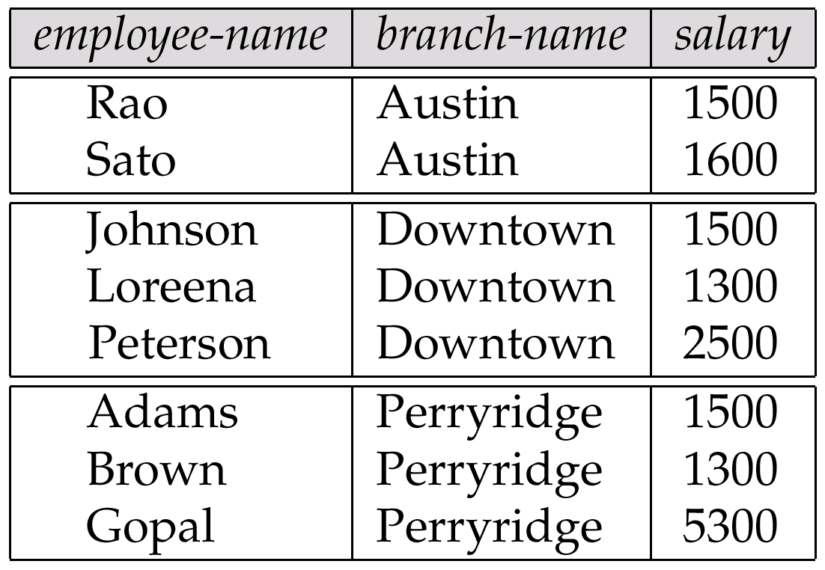
The pt-works Relation After Grouping

Slide 51
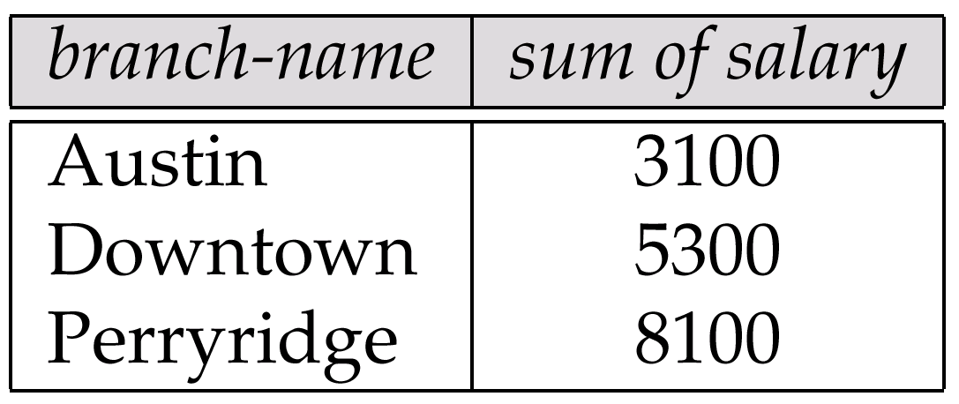
Result of _{branch-name} ς _{sum(salary)} (pt-works)

Slide 52
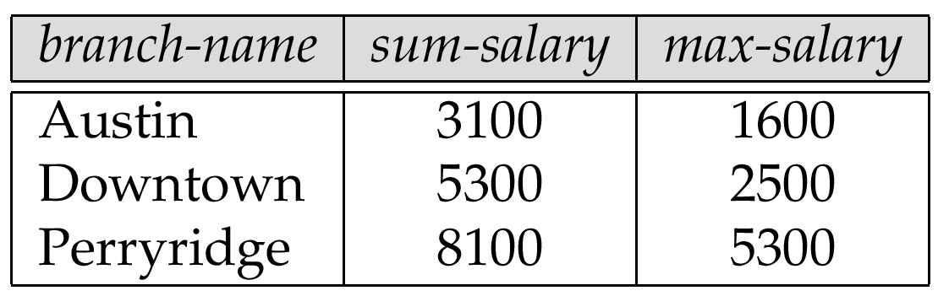
Result of _{branch-name} ς sum salary, max(salary) as max-salary (pt-works)

Slide 53
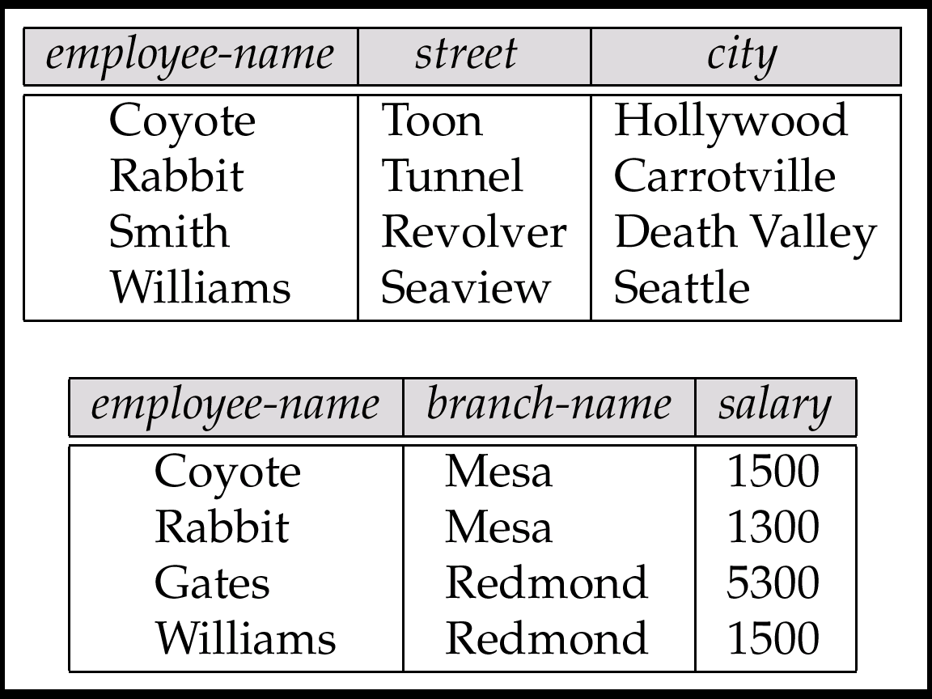
The employee and ft-works Relations

Slide 54
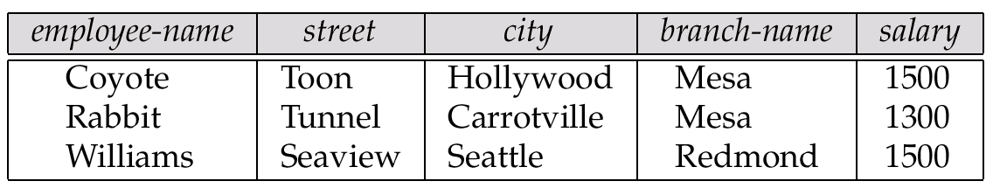
The Result of employee ft-works

Slide 55
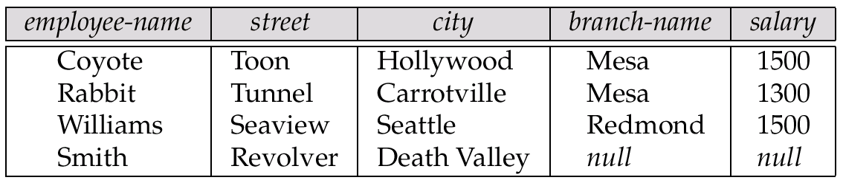
The Result of employee ft-works

Slide 56
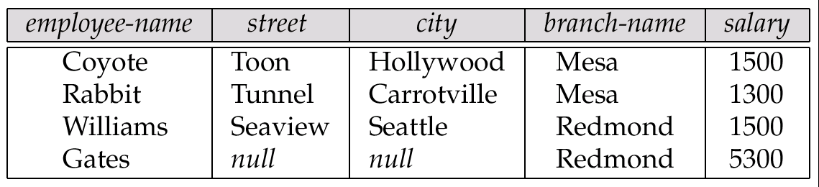
Result of employee ft-works

Slide 57
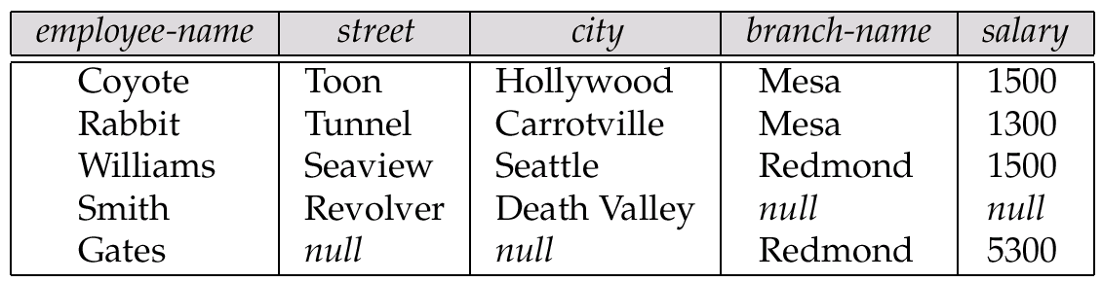
Result of employee ft-works

Slide 58
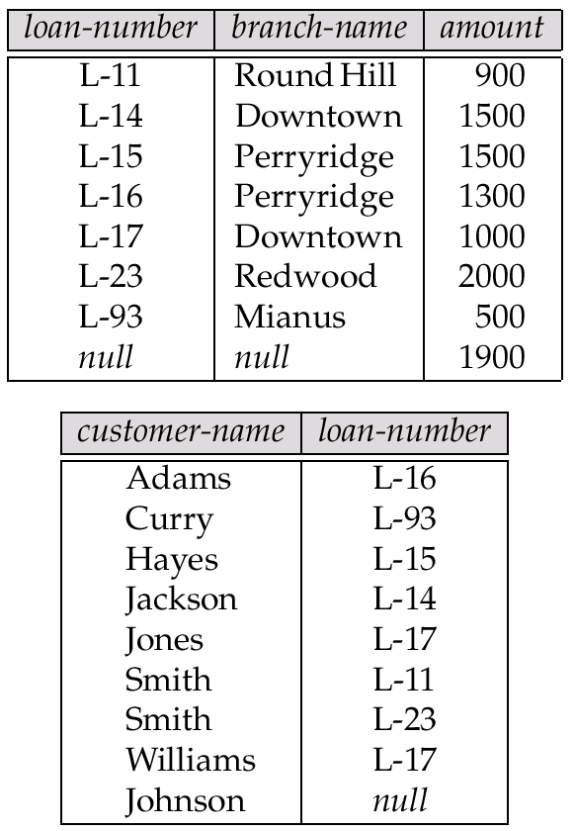
Tuples Inserted Into loan and borrower

Slide 59

Names of All Customers Who Have a Loan at the Perryridge Branch

Slide 60
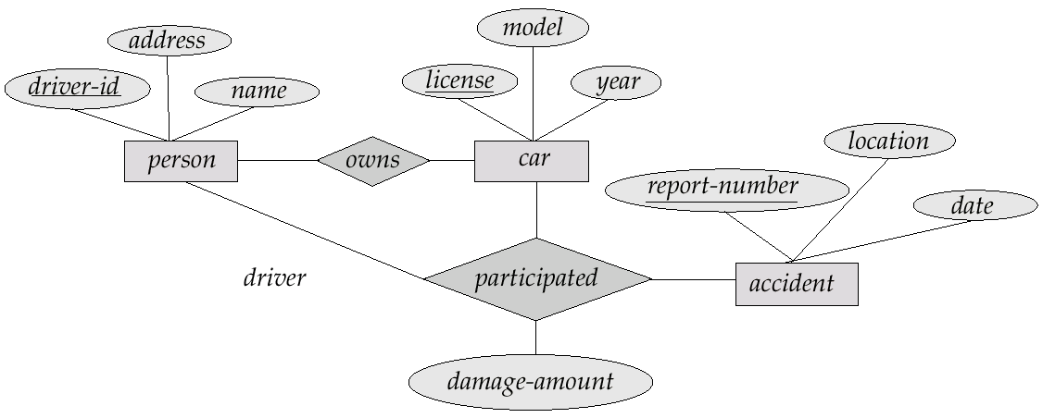
E-R Diagram

Slide 61

The branch Relation

Slide 62

The loan Relation

Slide 63

The borrower Relation

